Slide 1








Search Problems
A search problem consists of:
A state space
A successor function
(with actions, costs)
A start state and a goal test
A solution is a sequence of actions (a plan) which transforms the start state to a goal state
“N”, 1.0
“E”, 1.0
Notes:
Often comes back on exams
Goal test – sometimes more than one state that satisfies having achieved the goal, for example, “eat all the dots”
Abstraction

Slide 2
State Space Graphs
State space graph: A mathematical representation of a search problem
Nodes are (abstracted) world configurations
Arcs represent successors (action results)
The goal test is a set of goal nodes (maybe only one)
In a state space graph, each state occurs only once!
We can rarely build this full graph in memory (it’s too big), but it’s a useful idea

Slide 3
State Space Graphs
State space graph: A mathematical representation of a search problem
Nodes are (abstracted) world configurations
Arcs represent successors (action results)
The goal test is a set of goal nodes (maybe only one)
In a search graph, each state occurs only once!
We can rarely build this full graph in memory (it’s too big), but it’s a useful idea
a
G
b
c
e
d
f
S
h
p
q
r
Tiny search graph for a tiny search problem

Slide 4
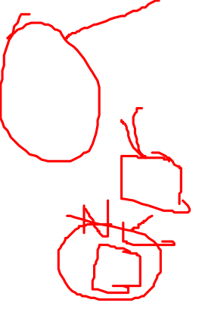
Search Trees
This is now / start
“N”, 1.0
“E”, 1.0
Possible futures
A search tree:
A “what if” tree of plans and their outcomes
The start state is the root node
Children correspond to successors
Nodes show states, but correspond to PLANS that achieve those states
For most problems, we can never actually build the whole tree
Notes:
Different plans that achieve the same state, will be different nodes in the tree.

Slide 5
State Space Graphs vs. Search Trees
State Space Graph
Each NODE in in the search tree is an entire PATH in the state space graph.
Search Tree
S
a
G
d
e
p
b
c
q
b
c
e
h
r
d
e
f
a
a
h
r
p
q
f
S
h
We construct both on demand – and we construct as little as possible.
p
q
f
q
c
G
p
q
r
q
c
G
a
a

Slide 6

Quiz: State Space Graphs vs. Search Trees
Consider this 4-state graph:
How big is its search tree (from S)?
a
S
G
b
Important: Lots of repeated structure in the search tree!

Slide 7
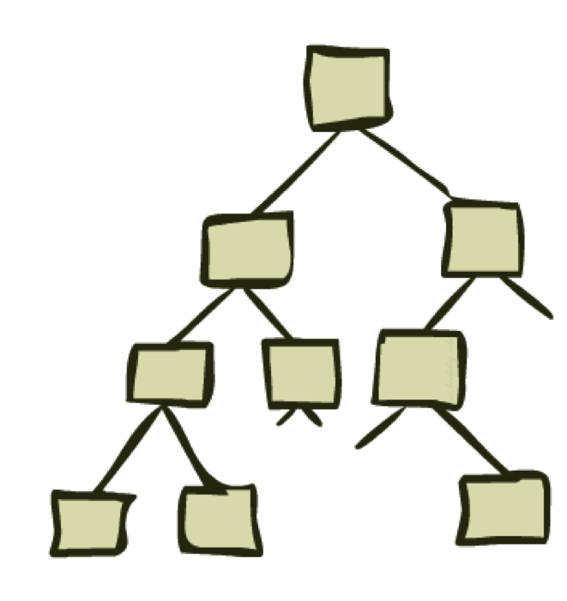
Tree Search

Slide 8

Search Example: Romania

Slide 9
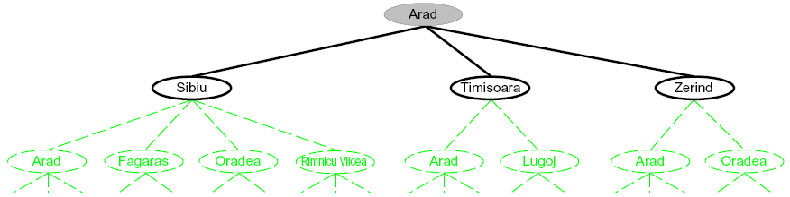
Searching with a Search Tree
Search:
Expand out potential plans (tree nodes)
Maintain a fringe of partial plans under consideration
Try to expand as few tree nodes as possible

Slide 10

General Tree Search
Important ideas:
Fringe
Expansion
Exploration strategy
Main question: which fringe nodes to explore?

Slide 11

Example: Tree Search
a
G
b
c
d
e
f
S
h
p
q
r
Notes:
Left: show tree
Right: fringe

